Slide 1
Money Management & Budgeting
Creating a Spending Plan
Credit report
Understanding the cost of borrowing
How to communicate with your creditors

Slide 2

Elena Jara
Director of Education
Credit Canada Debt Solutions

Slide 3
Question:
How many of you have or created a budget recently?

Slide 4



Sometimes, Life Happens

Slide 5

Concerned about your budget?
What is the difference between a regular budget and crisis budget?

Slide 6
Concerned about your budget?
A crisis budget helps you identify the items on your budget that are essential and those that are not.

Slide 7
Concerned about your budget?
Remember that these extra budget cuts are just temporary.
Notes:
It's understandable that the thought of an even stricter "crisis" budget might seem impossible. Again, you have to remember that these extra budget cuts are temporary.

Slide 8
Concerned about your budget?
Where do you start?

Slide 9
Concerned about your budget?
Start by thinking about the things you spend money on right now that you can live without for a few months.
Notes:
Start by thinking about the things you spend money on right now that you can live without for a few months (or however long you foresee your financial state to remain in trouble) and cut them out of your budget.

Slide 10
Concerned about your budget?
Things that are needs can stay, while things that are wants should be removed until you're financially ready to pay for them again.

Slide 11
Concerned about your budget?
Next - Identify your needs and your wants

Slide 12
Concerned about your budget?
NEEDS | WANTS
•Rent/Mortgage •Utility Bills •Groceries •Gas for car •Insurance | •Dinners out •Movie tickets •Hair/Cosmetics •Top-tier cell phone data plans/Cable TV packages

Slide 13

First of all, it's a good idea to create a crisis budget for your own situation as it is right now.

Slide 14


Budget tools
Online – tools $$$
Old school tools – pen & paper (FREE)

Slide 15
Free down loadable
Track, Trim and Target!
Notes:
After you track your spending habits for a little while, you may realize that you are spending more money than you are making! You will also see where you are spending too much money!
In some cases, it’s not hard to cut your expenses. For others, it may be very hard. For example, you do have to pay your rent and electricity bills, but you don’t need that new CD.
This is where you give out the tracking/budgeting books from Credit Canada and Consolidated.

Slide 16
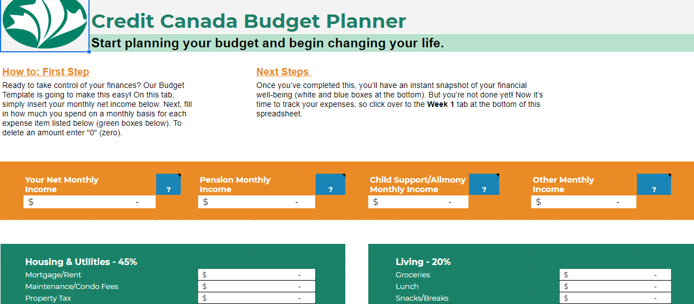
FREE - To create your regular monthly household budget, visit our website and download our budget calculator.

Slide 17
Monthly expense – work sheet
MONTHLY NET INCOME
______ $____
______ $____
______ $____
_______ $____
TOTAL INCOME
$____________
MONTHLY FIXED EXPENSES
Rent $____
_______ $____
_______ $____
_______ $____
TOTAL FIXED
$____________
MONTHLY AVAILABLE INCOME
Total Monthly Net Income $_____
Less Fixed Expenses $_____
Less variable expenses $_____
SURPLUS/DEFICIT
$____________
Flexible Expenses | What are you spending | Possibilities | Could be
Groceries
Laundry
Entertainment
Transportation
Clothing
Personal Grooming
Pets
Other…..
Credit Card & loan payments
Total
Notes:
This is the handout.
So, now you have filled out all of the information, it’s time to move to Step 3, and total it up!

Slide 18

A good place to start with regards to income is to re-do your budget as if you had half of your income available.

Slide 19

Surprises happen in life and not all of them are positive. Make your crisis budget as extreme as you think it needs to be.

Slide 20
Regular Spending Budget | Crisis Budget
Income: $4000 | Income: 2000
Rent/Mortgage: $1500 Utilities: 200 Internet/Cable TV: 160 Cell Phone Plan: 200 Insurance: 250 Car Payment: 250 Car maintenance: 100 Gas: 160 Clothes: 100 Groceries: 350 Meals Out: 150 Entertainment: 250 Gym: 40 Other irregular expenses: 100
Total Expense: $3810 Surplus $190 | Total Expenses: $

Slide 21
What can we ask about deferring temporarily?
Regular Spending Budget | Crisis Budget
Income: $4000 | Income: 2000
Rent/Mortgage: $1500 Utilities: 200 Internet/Cable TV: 160 Cell Phone Plan: 200 Insurance: 250 Car Payment: 250 Car maintenance: 100 Gas: 160 Clothes: 100 Groceries: 350 Meals Out: 150 Entertainment: 250 Gym: 40 Other irregular expenses: 100
Total Expense: $3810 Surplus $190 | Total Expenses: $

Slide 22
What can we ask about deferring temporarily?
Regular Spending Budget | Crisis Budget
Income: $4000 | Income: 2000
Rent/Mortgage: $1500 Utilities: 200 Internet/Cable TV: 160 Cell Phone Plan: 200 Insurance: 250 Car Payment: 250 Car maintenance: 100 Gas: 160 Clothes: 100 Groceries: 350 Meals Out: 150 Entertainment: 250 Gym: 40 Other irregular expenses: 100
Total Expense: $3810 Surplus $190 | Total Expenses: $
Rent/Mortgage: $1500
Car Payment: $250

Slide 23
What will go down anyway?
Regular Spending Budget | Crisis Budget
Income: $4000 | Income: 2000
Rent/Mortgage: $1500 Utilities: 200 Internet/Cable TV: 160 Cell Phone Plan: 200 Insurance: 250 Car Payment: 250 Car maintenance: 100 Gas: 160 Clothes: 100 Groceries: 350 Meals Out: 150 Entertainment: 250 Gym: 40 Other irregular expenses: 100
Total Expense: $3810 Surplus $190 | Total Expenses: $

Slide 24
What will go down anyway?
Regular Spending Budget | Crisis Budget
Income: $4000 | Income: 2000
Rent/Mortgage: $1500 Utilities: 200 Internet/Cable TV: 160 Cell Phone Plan: 200 Insurance: 250 Car Payment: 250 Car maintenance: 100 Gas: 160 Clothes: 100 Groceries: 350 Meals Out: 150 Entertainment: 250 Gym: 40 Other irregular expenses: 100
Total Expense: $3810 Surplus $190 | Total Expenses: $
Car Maintenance: $100
Gas: $160
Meals Out: $150
Entertainment: $250

Slide 25
Where can we ask for reductions?
Regular Spending Budget | Crisis Budget
Income: $4000 | Income: 2000
Rent/Mortgage: $1500 Utilities: 200 Internet/Cable TV: 160 Cell Phone Plan: 200 Insurance: 250 Car Payment: 250 Car maintenance: 100 Gas: 160 Clothes: 100 Groceries: 350 Meals Out: 150 Entertainment: 250 Gym: 40 Other irregular expenses: 100
Total Expense: $3810 Surplus $190 | Total Expenses: $

Slide 26
Where can we ask for reductions?
Regular Spending Budget | Crisis Budget
Income: $4000 | Income: 2000
Rent/Mortgage: $1500 Utilities: 200 Internet/Cable TV: 160 Cell Phone Plan: 200 Insurance: 250 Car Payment: 250 Car maintenance: 100 Gas: 160 Clothes: 100 Groceries: 350 Meals Out: 150 Entertainment: 250 Gym: 40 Other irregular expenses: 100
Total Expense: $3810 Surplus $190 | Total Expenses: $
Internet/Cable TV: $160
Cell Phone Plan: $200
Insurance: $250

Slide 27
Other areas for cutbacks?
Regular Spending Budget | Crisis Budget
Income: $4000 | Income: 2000
Rent/Mortgage: $1500 Utilities: 200 Internet/Cable TV: 160 Cell Phone Plan: 200 Insurance: 250 Car Payment: 250 Car maintenance: 100 Gas: 160 Clothes: 100 Groceries: 350 Meals Out: 150 Entertainment: 250 Gym: 40 Other irregular expenses: 100
Total Expense: $3810 Surplus $190 | Total Expenses: $

Slide 28
Other areas for cutbacks?
Regular Spending Budget | Crisis Budget
Income: $4000 | Income: 2000
Rent/Mortgage: $1500 Utilities: 200 Internet/Cable TV: 160 Cell Phone Plan: 200 Insurance: 250 Car Payment: 250 Car maintenance: 100 Gas: 160 Clothes: 100 Groceries: 350 Meals Out: 150 Entertainment: 250 Gym: 40 Other irregular expenses: 100
Total Expense: $3810 Surplus $190 | Total Expenses: $
Clothes: $100
Gym: $ 40

Slide 29
Now how does it look?
Regular Spending Budget | Crisis Budget
Income: $4000 | Income: $2000
Rent/Mortgage: $1500 Utilities: 200 Internet/Cable TV: 160 Cell Phone Plan: 200 Insurance: 250 Car Payment: 250 Car maintenance: 100 Gas: 160 Clothes: 100 Groceries: 350 Meals Out: 150 Entertainment: 250 Gym: 40 Other irregular expenses: 100 | Rent/Mortgage: $ - Utilities: 200 Internet/Cable TV: 100 Cell Phone Plan: 70 Insurance: 200 Car Payment: - Car maintenance: - Gas: 80 Clothes: - Groceries: 500 Meals Take-out: 100 Entertainment: 50 Gym: - Other irregular expenses: 100
Total Expense: $3810 Surplus $190 | Total Expenses: $1400 Surplus (hold this to catch up later) $ 600
Notes:
Comfort food

Slide 30
Other areas for reduction
Regular Spending Budget | Crisis Budget
Income: $4000 | Income: $2000
Rent/Mortgage: $1500 Utilities: 200 Internet/Cable TV: 160 Cell Phone Plan: 200 Insurance: 250 Car Payment: 250 Car maintenance: 100 Gas: 160 Clothes: 100 Groceries: 350 Meals Out: 150 Entertainment: 250 Gym: 40 Other irregular expenses: 100 | Rent/Mortgage: $ - Utilities: 200 Internet/Cable TV: 100 Cell Phone Plan: 70 Insurance: 200 Car Payment: - Car maintenance: - Gas: 80 Clothes: - Groceries: 500 Meals Take-out: 100 Entertainment: 50 Gym: - Other irregular expenses: 100
Total Expense: $3810 Surplus $190 | Total Expenses: $1400 Surplus (hold this to catch up later) $ 600
Notes:
Comfort food

Slide 31
Warning – Only Temporary Savings
Regular Spending Budget | Crisis Budget
Income: $4000 | Income: $2000
Rent/Mortgage: $1500 Utilities: 200 Internet/Cable TV: 160 Cell Phone Plan: 200 Insurance: 250 Car Payment: 250 Car maintenance: 100 Gas: 160 Clothes: 100 Groceries: 350 Meals Out: 150 Entertainment: 250 Gym: 40 Other irregular expenses: 100 | Rent/Mortgage: $ - Utilities: 200 Internet/Cable TV: 100 Cell Phone Plan: 70 Insurance: 200 Car Payment: - Car maintenance: - Gas: 80 Clothes: - Groceries: 500 Meals Take-out: 100 Entertainment: 50 Gym: - Other irregular expenses: 100
Total Expense: $3810 Surplus $190 | Total Expenses: $1400 Surplus (hold this to catch up later) $ 600
Notes:
Comfort food

Slide 32
Work out your options …

Slide 33
Understanding your credit report

Slide 34
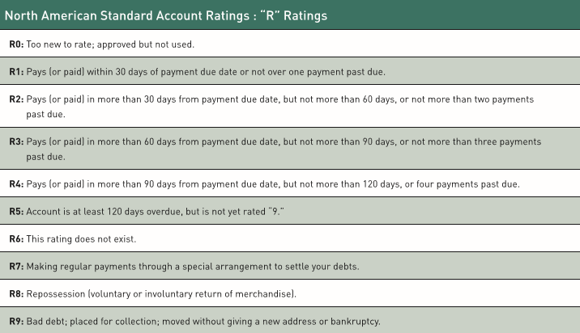

Slide 37
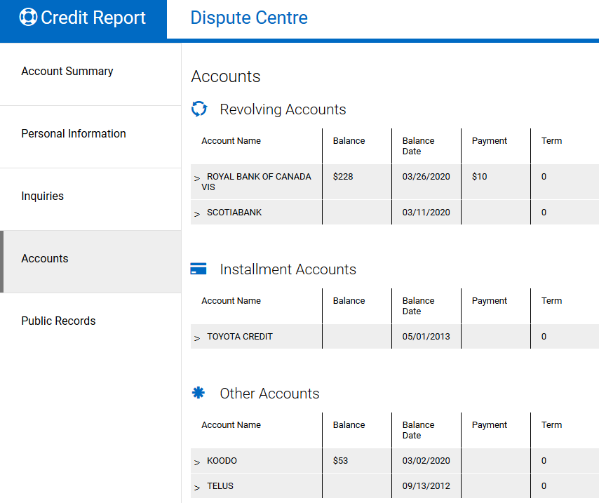

Slide 38
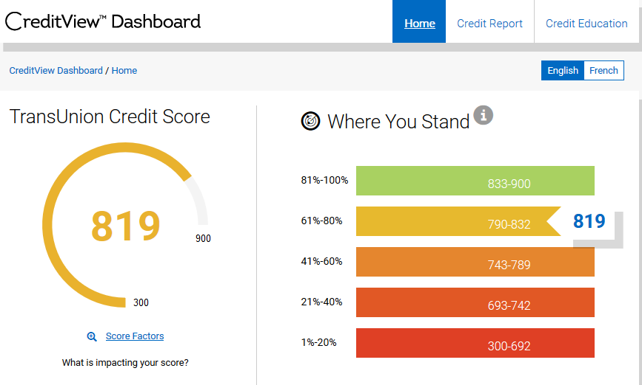

Slide 39
Credit-Scoring Formula

Slide 40
Elements of the Formula

Slide 41
Payment History
35%

Slide 44
Credit Utilization
30%

Slide 45
Credit Utilization
Credit Used
$500
10%
Credit Limit
$5,000

Slide 46
Credit Utilization
Credit Used
$2,500
50%
Credit Limit
$5,000

Slide 47
Credit Utilization
Credit Used
$4,500
90%
Credit Limit
$5,000
Credit Usage 0%-35% - Low Risk
Credit Usage 35%-70% - Medium Risk
Credit Usage 70%-100% - High Risk

Slide 49
Length of History
15%

Slide 51
Credit Mix
10%

Slide 54
Inquiries
10%

Slide 55
But what about COVID-19?

Slide 56
Payment History
35%
What happens if I defer any payments?

Slide 57
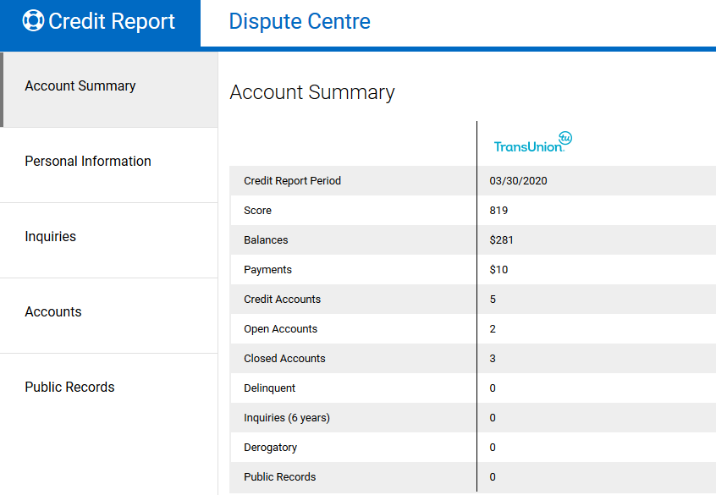

Slide 58
Or maybe not

Slide 59
Credit Utilization
30%

Slide 60
Credit Utilization
Credit Used
$4,500
90%
Credit Limit
$5,000
Credit Usage 0%-35% - Low Risk
Credit Usage 35%-70% - Medium Risk
Credit Usage 70%-100% - High Risk

Slide 61
Inquiries
10%

Slide 62

DISPUTES

Slide 63


Slide 64
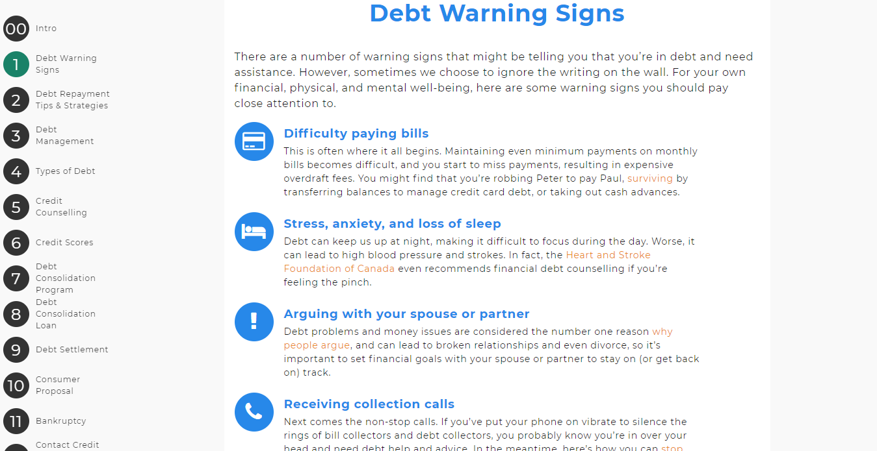

Slide 65


Experiences with Money
What is the first thing that comes to mind when you think about debt?
True or False –
Can a creditor come to your house?
Can a creditor call your neighbour?
Do creditors report every month to the credit bureaus?
Notes:
THIS IS AN ICE BREAKER
Tell me about how money makes you feel?
- empowered, happy?

Slide 66
Do you know what is the maximum interest rate you can be charged?

Slide 67


Slide 68
What is the Criminal Interest Rate in Canada?
Section 347 of the Criminal Code of Canada sets the maximum allowable annualized interest that may be charged at 60% – interest charged above that level is considered usury and is a criminal offence.

Slide 69

High interest rates
First and foremost, a subprime
loans typically comes with a higher
APR (Annual Percentage Rate) than a conventional loan does. The APR,
or annual percentage rate, is the interest rate of your loan expressed as a yearly rate.

Slide 70

High interest rates
The APR (annual percentage rate)
for a loan can include fees, like a fee
for originating the loan. The APR
gives you a sense of how much it’ll actually cost you to borrow money.

Slide 71

Let’s run the math on a high-interest loan
The following is taken from the website of a Canadian
organization that offers loans
to customers with poor credit …

Slide 72


Formula for calculating APR (Annual Percentage Rate)

Slide 73
I am going to borrow
$5,000
The repayment will be
$133.45
How often I will pay
Bi weekly
How long I will pay
60 months

Slide 74
I am going to borrow
$5,000
Math Time
$133.45
times 26
times 5
Equals $17,348.50
The repayment will be
$133.45
How often I will pay
Bi weekly
How long I will pay
60 months

Slide 75

This is how the math works when the annual interest rate is above 45%.

Slide 76
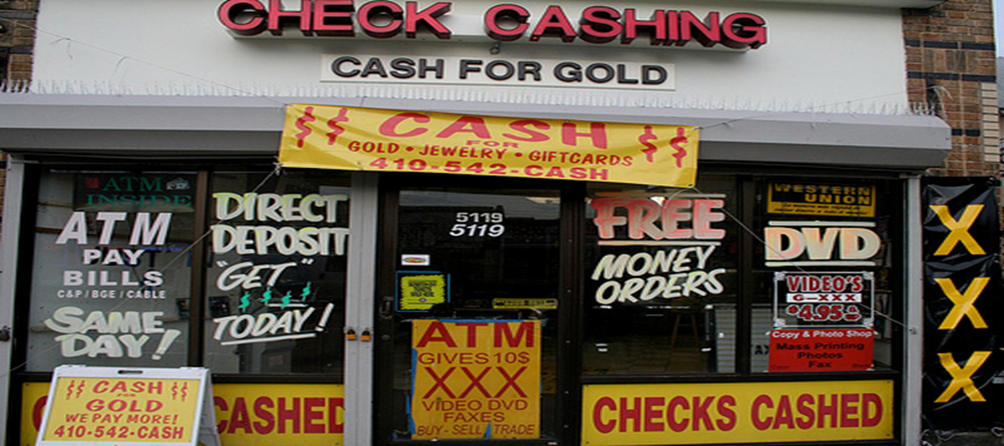
Alternative Financial Services
What are they?
Alternative financial services include payday lenders, pawnshops, cheque-cashing stores and other businesses.
Notes:
These organizations can charge additional service fees for those already provided by Financial Institutions that offer it for less or free.
When looking for services, be sure to compare costs associated with Alternative Services to that of regulated Financial Institutions
Facilitator to emphasize that some people don’t understand what Financial Institution’s can do for them. They may have a bad credit rating and think that the only services they can get is through Alternative Services. As well, they may have had a “Bad Experience” opening an account with a Financial Institution – this scares them into using the Alternative Services.
Trainer to ask class about their experiences and if they want to share!

Slide 77


Slide 78
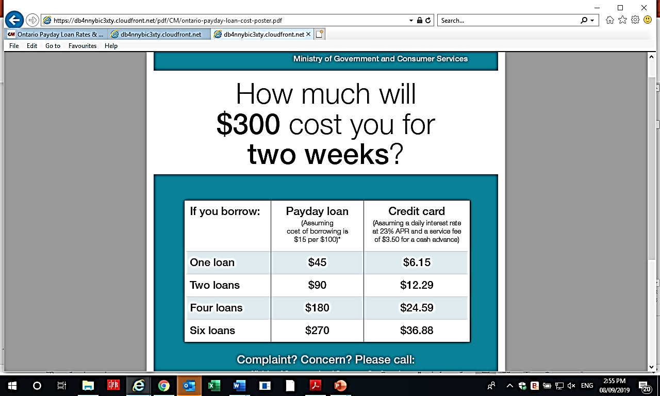

Slide 79
Here’s how payday loan interest works:
You borrow $100 for a period of 2 weeks and pay $15 in fees
(under Ontario law).

Slide 80
Here’s how payday loan interest works:
Borrow $100 for 26 periods through a payday loan you pay a total of $390 in fees.
$15 per period times 26 weeks = $390 in fees or roughly 390% per year on the $100 you borrowed.

Slide 81

Service Complaints
What can I do if I have a problem with an Alternative Financial Service?
File a complaint with the:
Notes:
Trainer to ask if anyone has ever had any problems with Financial Institutions?

Slide 82
How to communicate with the creditors

Slide 83

First important question –
Who’s calling who?

Slide 84
Situation #1
You are reaching out to your creditor.

Slide 85

You got a loan or a credit card,
you signed an agreement with a creditor.

Slide 86

This agreement could have been for any of the following:
A mortgage
A loan e.g. car loan
A credit card

Slide 87
The agreement had a variety of terms, such as:
The amount of credit
Interest rate
Repayment terms – how long, how often, how much

Slide 88

And then, times changed …

Slide 89

And your budget blew up …
And paying everything stopped being possible …

Slide 90
Let’s go back and look at those terms again … in particular …
Repayment terms – how long, how often, how much

Slide 91
So you’re going to ask the creditor for a variation of terms …

Slide 92
And the creditor will want to know …
Why should I do that for you?

Slide 93

Explain – very briefly – your current situation and how COVID-19 has affected you.
Can you explain your situation in a couple of sentences?

Slide 94

How do they want you to communicate with them?
On their website - webform
Speak with an advisor
  This may depend on what manner of assistance you are looking for

Slide 95
Are they willing to help?
What help are they offering?
What exactly are you looking for?
Payment deferrals
  Mortgages, loans, credit cards
Other hardship relief
  Refinancing, credit restructuring

Slide 96

Ask for the agreement in writing.
This will help if there are any misunderstandings later on.
Please feel free to download the COVID-19 Letter to Creditors that we are including with this webinar.

Slide 97

Getting to this point assumes you still have a good working relationship with your creditor.
You will need to contact them BEFORE your account is past due.

Slide 98
Situation #2
You are being contacted.

Slide 99

So who is calling?
Is it the original creditor?
Or is it a collection agency?

Slide 100

Tips for dealing with creditors
When ever possible deal directly with the original Creditor(s)
If possible, try to work out an agreement with your creditors before a your debt is sent to collections. While late payments affect your credit reports and scores, collection accounts can result in even greater damage.

Slide 101
Tips for dealing with creditors
Explain your situation
Creditors need to know if you are in a hardship situation and what you are trying to do to get back on track.
Be consistent when you talk with creditors.
Be truthful! If you tell everyone a different story, especially one that’s not true, it’s bound to backfire.

Slide 102
Tips for dealing with creditors
Stay calm
No matter what the person on the other end of the line says. You’ll get nowhere if you lose your temper. If you find yourself losing your cool, just tell the collector you’ll have to talk with them later and hang up.

Slide 103
Tips for dealing with creditors
You have the right to ask Questions
If a collector says you’ll be sued, or that you’ll lose property if you don’t pay, just calmly ask for specifics: “When can I expect to receive the statement of claim?” Or “When will you take the money from my bank account?”

Slide 104
Tips for dealing with creditors
Take Notes
Make sure you write down the details of the conversation whenever you talk with a collector.
Write down the name of the person you talked to
when you talked, and what was discussed
Your notes will provide you with a record in case you need it

Slide 105
Tips for dealing with creditors
Read (& Save) Your Mail and E-mails
Don’t throw away mail or delete emails from your creditors
Open it, read it, and save it in a file.

Slide 106
Tips for dealing with creditors
Let’s (try to) make a deal …
Be realistic with what you can Afford
Go over your income and expenses with a fine-tooth comb, figure out what you can afford, and only agree to pay a realistic amount. Generally, you can negotiate the best settlement on a debt if you can come up with a lump sum amount to resolve the debt.

Slide 107
Tips for dealing with creditors
Let’s (try to) make a deal …
Be realistic with what you can Afford
If you agree to a payment plan, you will likely pay more over time. If you do agree to a payment plan, make sure you understand the total amount you will pay.

Slide 108
Review your budget.
What can/can’t you afford to do? Don’t over-promise.

Slide 109
Tips for dealing with creditors
Let’s (try to) make a deal …
Get it in Writing
When you do come up with a payment arrangement, or a debt settlement letter, get it in writing before you pay a penny. Otherwise, the terms can change, and it will be your word against theirs.

Slide 110
Tips for dealing with creditors
Let’s (try to) make a deal …
Get Help When Negotiating With Creditors
If you are having trouble coming up with a repayment plan that works, find out whether a credit counselling agency can help you work something out with your creditors.

Slide 111
Tips for dealing with creditors
Think about your future credit score
Catching up on a delinquent account, or paying off a collection account, won’t improve your credit unless you can get the creditor to agree to remove the late payments.

Slide 112
Tips for dealing with creditors
Think about your future credit score
Late payments can stay on your credit report up to seven years from the original delinquency.

Slide 113
Tips for dealing with creditors
Remember –
You have rights with respect to how the debt is collected when dealing with a debt collector from a federally regulated financial institution or another party acting on its behalf.

Slide 114
Tips for dealing with creditors
Additional information about collection agencies is provided in the handouts for today’s webinar.

Slide 115


Slide 116

Need to talk to someone right now? Credit Canada is open for business and we are available to help!

